Slide 1
B. Tech. Project
Data Driven Modelling of Composites
Mid-Term Evaluation (4-2)
Advisor -
Prof. Siladitya Pal
Aman Shrivastava - 13117008
Mihir Ujjwal Rana - 13117044
Yash Sharma - 13117079

Slide 2
Project Objective
To develop an algorithmic framework to predict properties of composites to aid in meta-modelling process.

Slide 3
Recap of General Workflow
1. (a) Images
2. Structure Factor
3. Master Data
1. (b) Simulated Data
6. Trained Model
5. Machine Learning
4. Preprocessed Data
7. Predictions
8. Validation

Slide 4
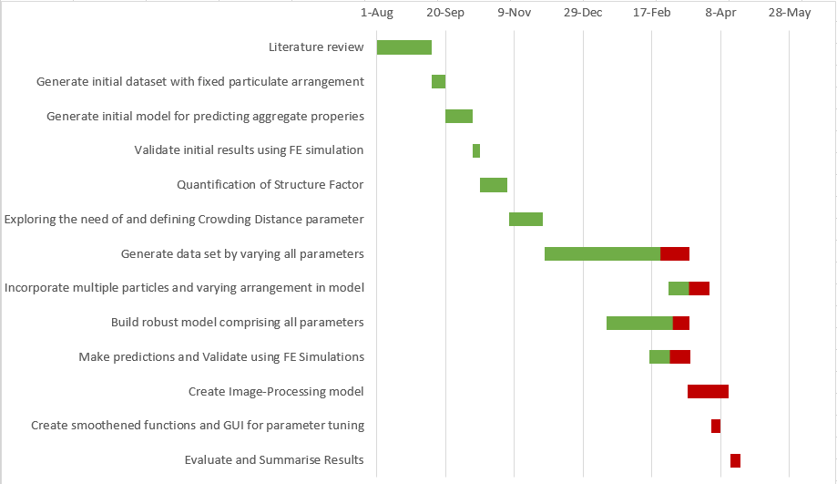
Project Timeline

Slide 5
Progress Made
Database Generation
Structure Factor Quantification
ML Model Generation
Generate database comprising composites with different properties (strength, volume fractions, etc.)
Create parameters to quantify difference in composites with same properties and volume fraction but different spatial arrangement of particles
Generate meta-model using Machine Learning algorithms
Making predictions using this model

Slide 6
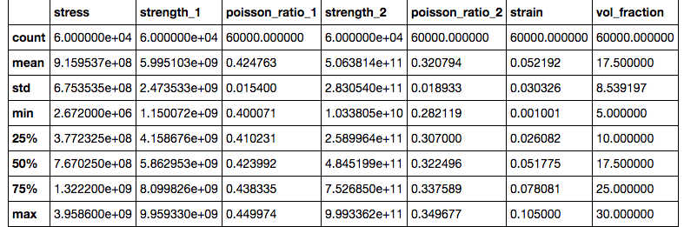
Summary of Dataset Generated
Total Size = 60,000
Number of unique materials = 100
1 = matrix
2 = particle

Slide 7
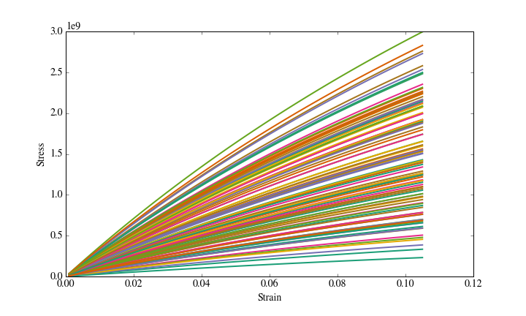
Stress-Strain Distribution for Different Materials at 10% Volume Fraction

Slide 8
Methodology
Generate Dataset by varying volume fraction and strain for different materials.
Merge the dataset of different material to create a unified dataset.
Separate data corresponding to a particular material for validation.
Train ML algorithms on the remaining material data.
Check the performance of model on the validation dataset.

Slide 9
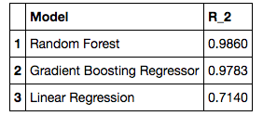
ML Algorithm Result
Best Result is shown by Bagging Algorithm.
Linear Regression performs poorly as the data is non-linear.
Results can be further improved by hyperparameter tuning.

Slide 10
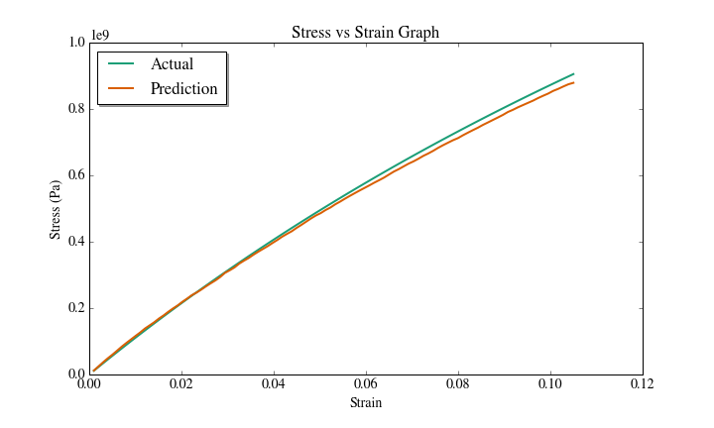
Result for One Material (20% VF)
20% VF

Slide 11
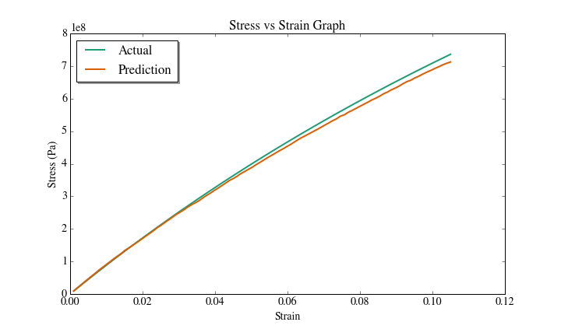
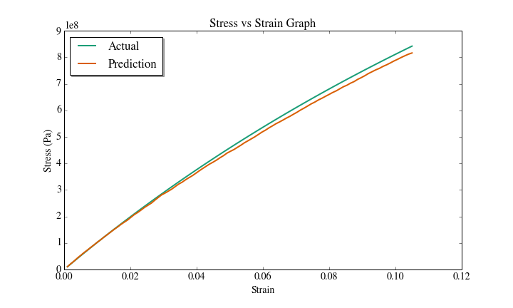
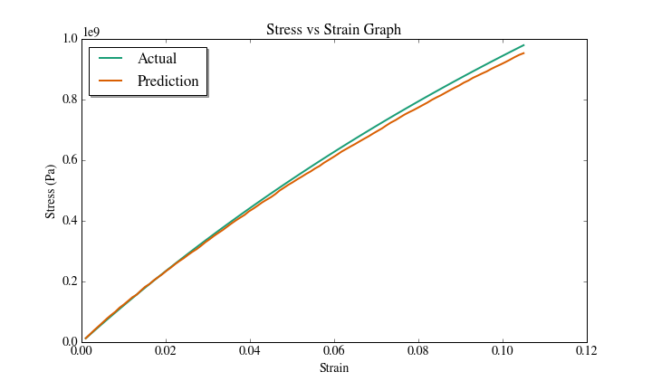

Results for Material (All VFs)
5% VF
10% VF
15% VF
20% VF
25% VF
30% VF

Slide 12
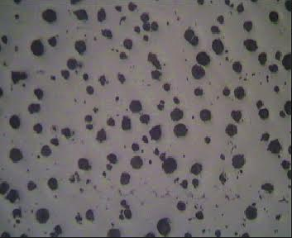
Structure Factor Quantification

Slide 13
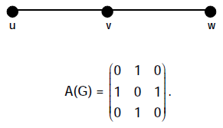


Structure Factor (Approach 1)
Distance Energy
The D-eigenvalues of a graph G are the eigenvalues of its distance matrix D , and the D-energy E_{D}(G) is the sum of the absolute values of its D-eigenvalues.
Two graphs are said to be D-equienergetic if they have the same D-energy. It has been proved that there exist pairs of non-D-cospectral D-equienergetic graphs of order n for every n ≥ 6 .

Slide 14
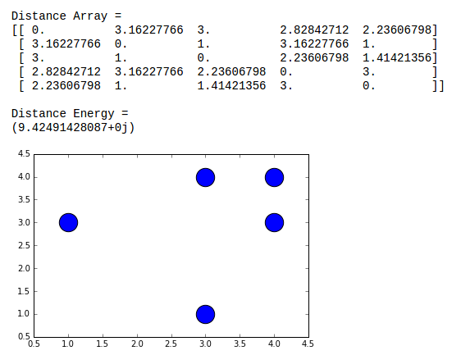
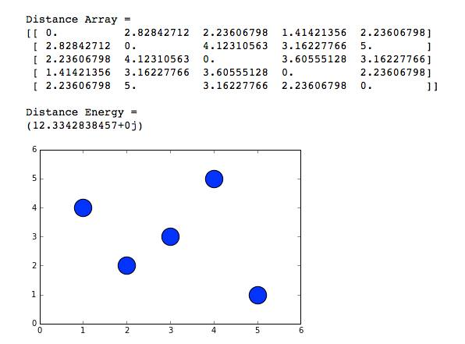
Distance Energy
Sample Computation for Two Configurations of a 5 particle system

Slide 15
D-Energy of both are equal. Thus, we need to define another parameter.
Need for Crowding Quantification
It has been proved that there exist pairs of non-D-cospectral D-equienergetic graphs of order n for every n ≥ 6.
This means that whenever n ≥ 6, there exists at least one pair of arrangements where D-energies are equal.
To distinguish between these arrangements, we need one more parameter.
This parameter can be defined in terms of Crowding Distance of particles.

Slide 16
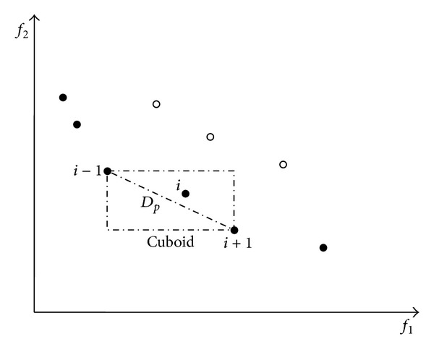
Crowding Distance
The crowding distance value of a solution provides an estimate of the density of solutions surrounding that solution. The crowding distance value of a particular solution is the average distance of its two neighboring solutions.

Slide 17
Structure Factor (Approach 2)
Crowding Factor
The theory behind the factor is related to the amount of "room" a fiber needs to rotate without touching other fibers. The crowding factor is directly proportional to the consistency.
It is proportional to the square of the ratio of fiber length to diameter. Two samples having the same crowding factor are likely to yield sheets having the same uniformity of formation hence stress-strain properties, assuming that all other factors are equal.
N = VF / D²

Slide 18
Activities to be Followed
Generation of large database by varying all remaining parameters (, porosity, etc.)
Building composites with multi-particle system and different spatial arrangements
Generation of an Image-Processing based engine to directly identify all particles and their respective locations from image for inputting in the ML model. [If time permits]
Creation of GUI with slider panel for tuning parameters like strain, volume fraction, etc., and training model according to these parameters.
Validation of model by comparison with direct FE simulation and recorded experimental data, according to an appropriate confidence interval band.
Evaluating and summarising results.

Slide 19
Additional Help Required
High performance workstations are a must for our efforts to fructify. We have gained access to high parallel-computing power available in our advisor’s office and at the ICC.
Since the validation process comprises comparison with real data, we would need FE simulated data to compare the material properties with our predictions. Simulations would primarily be handled by our advisor.

Slide 20
References
Balakrishnan R., The Energy of a Graph Linear Algebra and Its Applications, 387, (2004), 287-295.
N. Murugesan, K. Meenakshi, Skew Energy of Digraphs and Relation Between Graph Energy and Distance Energy, International Journal of Combinatorial Graph Theory and Applications (2011), 161-174
Agrawal, Ankit, Choudhary Alok, Perspective: Materials informatics and big data: Realization of the “fourth paradigm” of science in materials science, APL Materials (2016)
Balachandran Prasanna, Xue Dezhen, Theiler James , Adaptive Strategies for Materials Design using Uncertainties, Scientific Reports (2015)
Doreswamy, Hemanth. K. S, Performance Evaluation of Predictive Classifiers For Knowledge Discovery From Engineering Materials Data Sets, CiiT Journal (2003)
Xue Dezhen, Balachandran Prasanna,Hogden John, Accelerated search for materials with targeted properties by adaptive design, Nature (2016)

Slide 21
Thank You!
Any Questions?

